Slide 1

Mind Wandering ML Development Process
Jamie MacDonald, Jui Das, Delaram Bahreini

Slide 2
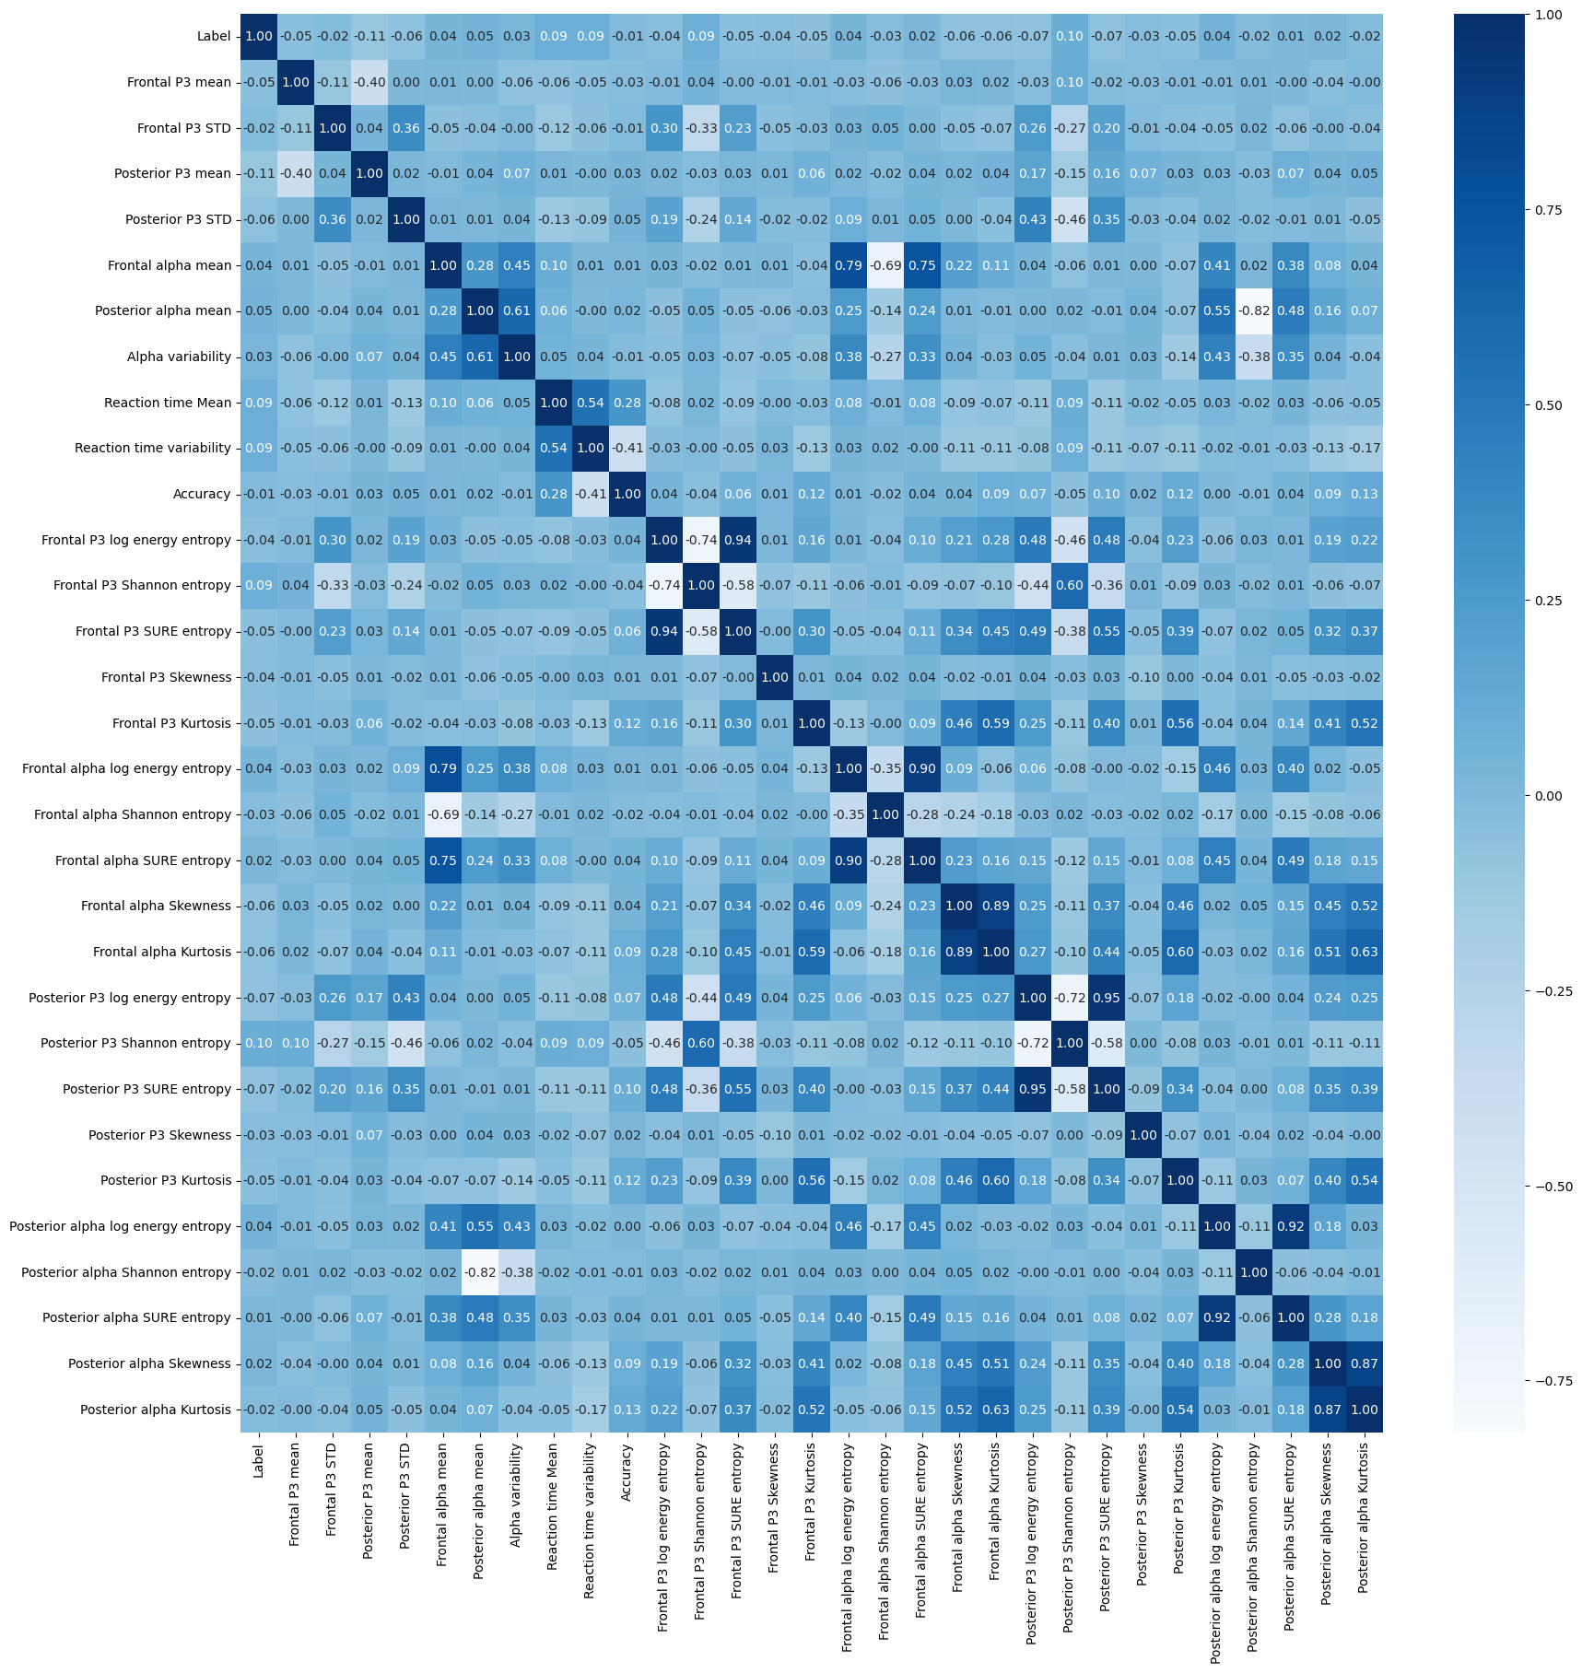
Feature Selection – Correlation Matrix
Features with correlation >80% were excluded:
Frontal P3 log energy entropy
Frontal alpha log energy entropy
Frontal alpha Kurtosis
Posterior P3 log energy entropy
Posterior alpha log energy entropy
Posterior alpha Kurtosis

Slide 4
Model Comparison
Before Tuning Hyperparameters

Slide 5
Initial Model Comparison
Classifier Name | ROC AUC¹ | Accuracy | Precision | Balanced Accuracy | MCC
Cat Boost Classifier | 0.563 | 0.783 | 0.309 | 0.783 | 0.583
Gradient Boosting Classifier | 0.559 | 0.707 | 0.353 | 0.707 | 0.428
Light Gradient Boosting Machine Classifier (LGBMClassifier) | 0.559 | 0.743 | 0.362 | 0.744 | 0.494
Random Forest Classifier | 0.552 | 0.759 | 0.342 | 0.759 | 0.528
eXtreme Gradient Boost Classifier (XGBClassifier) | 0.551 | 0.741 | 0.332 | 0.741 | 0.490
Logistic Regression | 0.537 | 0.529 | 0.523 | 0.53 | 0.060
C-Support Vector Classification (SVC) | 0.528 | 0.545 | 0.684 | 0.545 | 0.095
K-nearest Neighbours Classifier | 0.523 | 0.643 | 0.495 | 0.643 | 0.292
¹was used as the ranking metric.
Notes:
Used ROC AUC as the ranking metric for the classifiers.

Slide 6
Initial Model Comparison
However, oversampling imbalanced data should be done within cross validation (Muralidhar, 2023; Brownlee, 2020) and these results were likely optimistic... Integrating SMOTE into the cross validation produced lower accuracy.

Slide 7
Realistic Model Comparison
Classifier Name | ROC AUC¹ | Accuracy | Precision | Balanced Accuracy | MCC
C-Support Vector Classification (SVC) | 0.535 | 0.489 | 0.283 | 0.528 | 0.0648
Logistic Regression | 0.534 | 0.504 | 0.283 | 0.526 | 0.0597
Random Forest Classifier | 0.520 | 0.656 | 0.295 | 0.523 | 0.0498
Light Gradient Boosting Machine Classifier (LGBMClassifier) | 0.517 | 0.646 | 0.288 | 0.517 | 0.0381
eXtreme Gradient Boost Classifier (XGBClassifier) | 0.516 | 0.633 | 0.284 | 0.517 | 0.0337
Cat Boost Classifier | 0.512 | 0.641 | 0.283 | 0.515 | 0.0312
K-nearest Neighbours Classifier | 0.510 | 0.541 | 0.268 | 0.508 | 0.0187
Gradient Boosting Classifier | 0.508 | 0.589 | 0.268 | 0.507 | 0.0143
¹was used as the ranking metric.
Notes:
Used ROC AUC as the ranking metric for the classifiers.

Slide 8
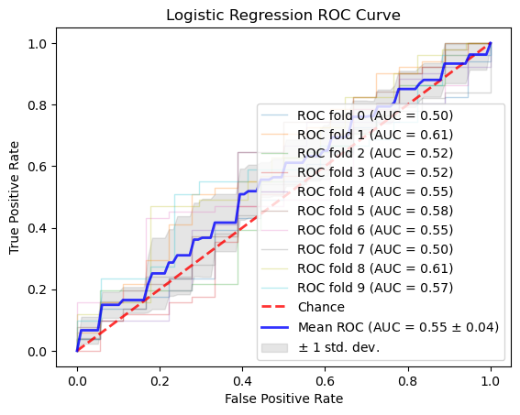
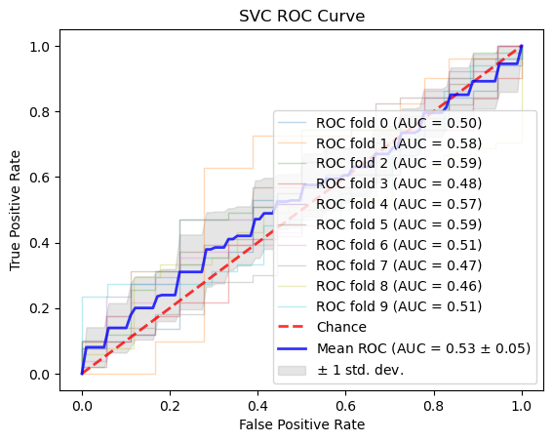
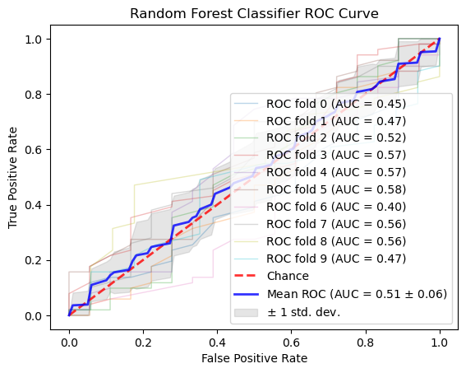
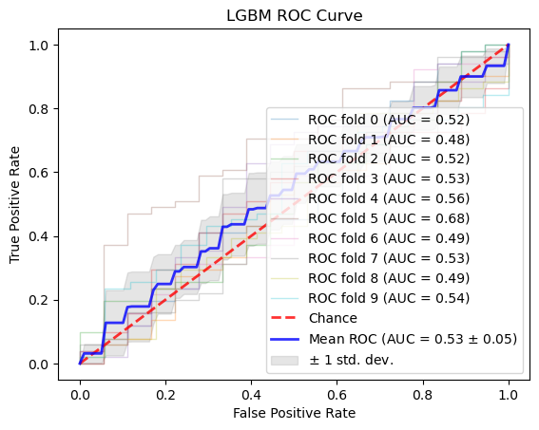

Slide 9
References
Brownlee, J. (2020, January 16). SMOTE for Imbalanced Classification with Python. MachineLearningMastery.Com. https://machinelearningmastery.com/smote-oversampling-for-imbalanced-classification/
Chawla, N. V., Bowyer, K. W., Hall, L. O., & Kegelmeyer, W. P. (2002). SMOTE: synthetic minority over-sampling technique. Journal of artificial intelligence research, 16, 321-357. https://doi.org/10.48550/arXiv.1106.1813
Muralidhar, K. S. V. (2023, July 7). The right way of using SMOTE with Cross-validation. Medium. https://towardsdatascience.com/the-right-way-of-using-smote-with-cross-validation-92a8d09d00c7

